Slide 1

Heaviest Segments in a Number Sequence
Kun-Mao Chao (趙坤茂)
Department of Computer Science and Information Engineering
National Taiwan University, Taiwan
WWW: http://www.csie.ntu.edu.tw/~kmchao

Slide 2
C+G rich regions
locate a region with high C+G ratio
ATGACTCGAGCTCGTCA
00101011011011010
Average C+G ratio

Slide 3
Defining scores for alignment columns
infocon [Stojanovic et al., 1999]
  Each column is assigned a score that measures its information content, based on the frequencies of the letters both within the column and within the alignment.
CGGATCAT—GGA
CTTAACATTGAA
GAGAACATAGTA

Slide 4
Maximum-sum segment
Given a sequence of real numbers a₁a₂…a_{n} , find a consecutive subsequence with the maximum sum.
9 –3 1 7 –15 2 3 –4 2 –7 6 –2 8 4 -9
For each position, we can compute the maximum-sum interval ending at that position in O(n) time. Therefore, a naive algorithm runs in O(n²) time.

Slide 5
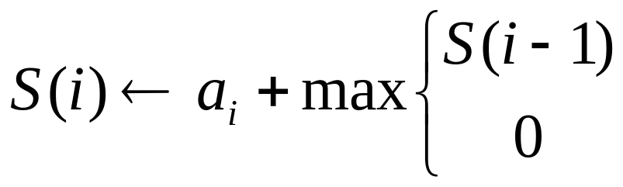
Maximum-sum segment
(The recurrence relation)
Define S(i) to be the maximum sum of the segments ending at position i.
a_{i}
If S(i-1) < 0, concatenating a_{i} with its previous segment gives less sum than a_{i} itself.

Slide 6
Maximum-sum segment
(Tabular computation)
9 –3 1 7 –15 2 3 –4 2 –7 6 –2 8 4 -9
S(i) 9 6 7 14 –1 2 5 1 3 –4 6 4 12 16 7
The maximum sum

Slide 7
Maximum-sum interval
(Traceback)
9 –3 1 7 –15 2 3 –4 2 –7 6 –2 8 4 -9
S(i) 9 6 7 14 –1 2 5 1 3 –4 6 4 12 16 7
The maximum-sum segment: 6 -2 8 4

Slide 8
Computing segment sum in O(1) time?
Input: a sequence of real numbers a₁a₂…a_{n}
Query: the sum of a_{i} a_{i+1}…a_{j}

Slide 9
Computing segment sum in O(1) time
prefix-sum(i) = S[1]+S[2]+…+S[i],
  all n prefix sums are computable in O(n) time.
sum(i, j) = prefix-sum(j) – prefix-sum(i-1)
i
j
prefix-sum(j)
prefix-sum(i-1)

Slide 10
Computing segment average in O(1) time
prefix-sum(i) = S[1]+S[2]+…+S[i],
  all n prefix sums are computable in O(n) time.
sum(i, j) = prefix-sum(j) – prefix-sum(i-1)
density(i, j) = sum(i, j) / (j-i+1)
i
j
prefix-sum(j)
prefix-sum(i-1)

Slide 11
Maximum-average segment
Maximum-average interval
3 2 14 6 6 2 10 2 6 6 14 2 1
The maximum element is the answer. It can be done in O(n) time.

Slide 12
Maximum average segments
Define A(i) to be the maximum average of the segments ending at position i.
How to compute A(i) efficiently?

Slide 13
Left-Skew Decomposition
Partition S into substrings S₁,S₂,…,S_{k} such that
  each S_{i} is a left-skew substring of S
    the average of any suffix is always less than or equal to the average of the remaining prefix.
  density(S₁) < density(S₂) < … < density(S_{k})
Compute A(i) in linear time

Slide 14
Left-Skew Decomposition
Increasingly left-skew decomposition (O(n) time)
5
6
7.5
5
8
7
8
9
8
9
8 2 7 3 8 9 1 8 7 9

Slide 15
Right-Skew Decomposition
Partition S into substrings S₁,S₂,…,S_{k} such that
  each S_{i} is a right-skew substring of S
    the average of any prefix is always less than or equal to the average of the remaining suffix.
  density(S₁) > density(S₂) > … > density(S_{k})
[Lin, Jiang, Chao]
  Unique
  Computable in linear time.
  The Inventors of the Right-Skew Decomposition (Oops! Wrong photo!)
  The Inventors of the Right-Skew Decomposition (This is a right one. more)

Slide 16
Right-Skew Decomposition
Decreasingly right-skew decomposition (O(n) time)
5
7.5
6
5
9
8
9
8
7
8
9 7 8 1 9 8 3 7 2 8

Slide 17
Right-Skew pointers p[ ]
5
7.5
6
5
9
8
9
8
7
8
9 7 8 1 9 8 3 7 2 8
1 2 3 4 5 6 7 8 9 10
p[ ] 1 3 3 6 5 6 10 8 10 10

